Slide 1
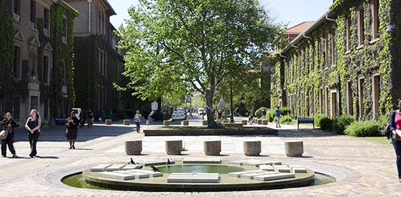
University of Cape Town
Faculty of Science
MAKING
CHOICES
on degrees, majors
and timetables
Hussein Suleman
Bette Davidowitz
2015

Slide 2
Part 0
Who are we?

Slide 3
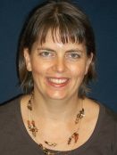
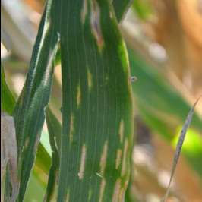
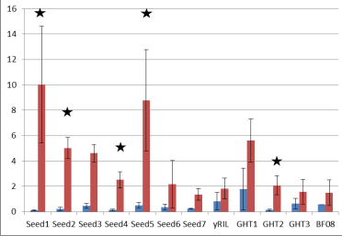
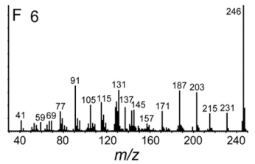
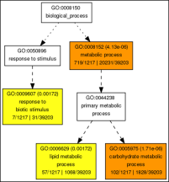
Introduction to Student Advisors
Department of Molecular and Cell Biology
(MCB)
Room 227B
Dr Shane Murray
Teach: 2nd, 3rd yr, BSc Hons; Genetics
Research: Disease resistance in maize
Microarray analysis
Gene expression
Metabolite profiling
Bioinformatics
Grey leaf spot infection

Slide 4
Part I
Where are you and where are you going?

Slide 5
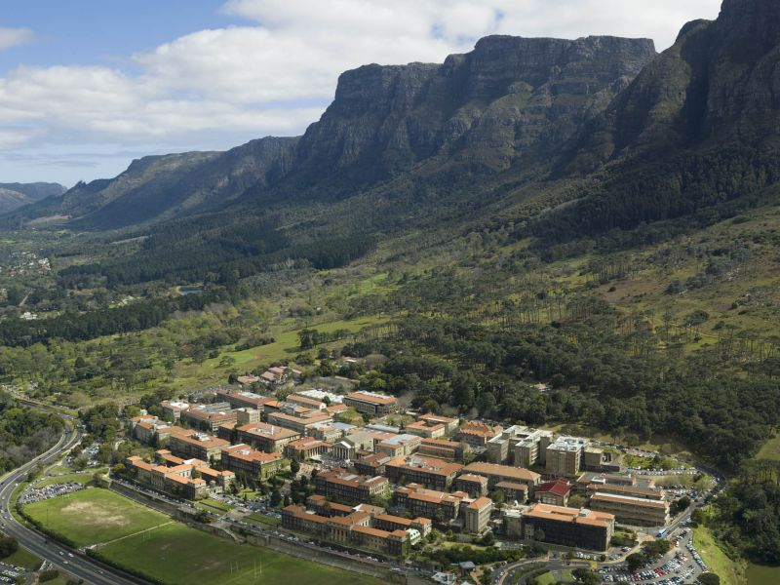
Table
Mountain
You are here
(RW James)
UCT

Slide 6
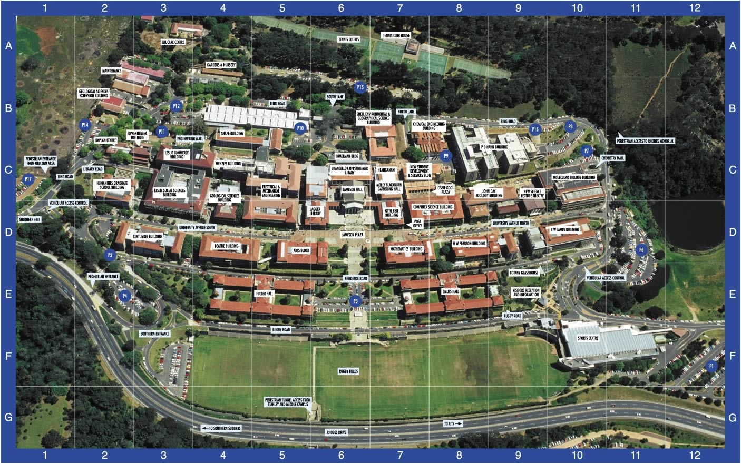
Science Faculty
Offices
(PD Hahn)
Geology
EGS
Chemistry
Statistics
MCB
Physics
Archaeology
Astronomy
Computer Science
Oceanography
Math / Applied Math
Biological Sciences

Slide 7
Questions to be addressed in this session
What is the structure of a BSc degree?
What are majors and courses, and how are these put together in a degree curriculum and timetable?
What choices do I have to make?
two majors
the right first year courses that will provide the foundation for chosen majors

Slide 8
Some other questions to be addressed during the rest of this week:
Where will my lectures be?
How do I get the most out of lectures and other learning opportunities?
Where do I go for help?
What if I get sick, or miss a test?
Look out for these in other sessions or ask your OL

Slide 9
What you will have done ... by Friday (5 Feb)
chosen your majors
chosen courses for your first year
completed registration forms with the help of a Student Adviser
submitted registration forms for processing
registered as a UCT Science student!

Slide 10
What you will have done ... by Wednesday (10 Feb)
be familiar with UCT computing systems
have some insights into how you will approach your academic studies
know where to go for help
be ready to attend your first lectures on ...
Friday 12 February 2016 !!!

Slide 11
Key people who are available to advise and assist
Orientation assistants
purple T-shirts
Student Advisers
advice on academic and curriculum matters
Faculty Office, level 6, PD Hahn Building
general queries re academic status, registration, etc.
Student Development Officer, Bhavani Krishna (via Faculty Office)
general advice and counselling

Slide 12
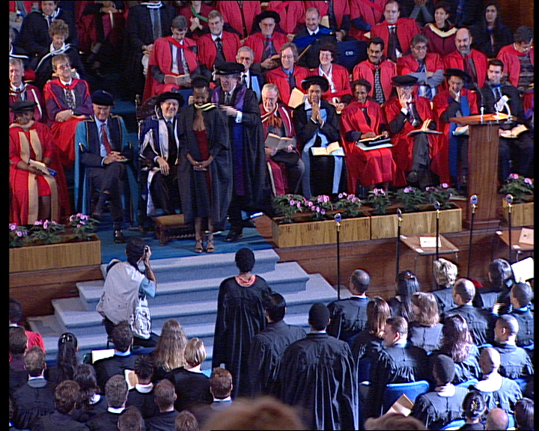
In a few years, we want to see you here
in a few more years, this could be you too

Slide 13
Part II
Your Choices Right Now

Slide 14
What is a major?
a three-year sequence of courses in a specific discipline
provides depth of knowledge in that discipline
often with pre-requisite or co-requisite courses that provide relevant knowledge in other disciplines
pre-requisite course: must be completed before
co-requisite course: must be done at the same time
elective course: chosen by you, counts towards course requirements of degree

Slide 15
Majors offered in the Science Faculty (Handbook - pages 13-19)
Majors offered in the Science Faculty (Handbook - pages 13-19)
2
2
Molecular & Chemical Sciences
Numerical Sciences
Biology, Earth & Environmental Sciences
Biochemistry
Chemistry
Genetics
Human
Anatomy &
Physiology
Applied Mathematics
Applied Statistics
Astrophysics
Business Computing
Computer Engineering
Computer Games
Development
Computer Science
Mathematics
Mathematical Statistics
Physics
Applied Biology
Archaeology
Ecology & Evolution
Environmental &
Geographical Science
Geology
Marine Biology
Ocean & Atmosphere
Science

Slide 16
How do I choose a major?
Questions to ask yourself:
What am I interested in?
What am I good at?
What kind of work am I interested in?
(is there any money in it?)
Attend information sessions today:
14h00 – attend one of the four sessions
15h00 – attend one of the four sessions

Slide 17
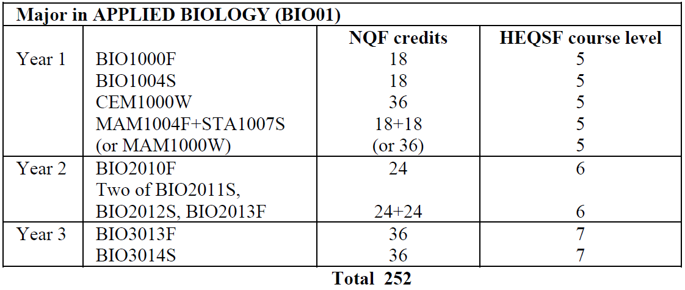
Where can I find full details on Majors?
8
8
Science Handbook, pages 13-19
Sample handbook entry

Slide 18
What makes up a Course?
3
typically 1 lecture per day + 1 practical or tutorial per week
structure of courses
W : full course; Whole year
F : half course; First semester
S : half course; Second semester
H : half course; Whole year
Example course code:
CSC1015F
duration
course code
first year
computer science

Slide 19
Weekly Timetable
7
7
Period
Mon
Tues
Wed
Thurs
Fri
1
MAM
MAM
MAM
MAM
MAM
2
CEM
CEM
CEM
CEM
CEM
3
PHY
PHY
PHY
PHY
PHY
4
5
BIO
BIO
BIO
BIO
BIO
6 - 8
Practicals and tutorials

Slide 20
Extended Degree Programme (EDP) Option of a BSc degree over 4 years
5
Success in your studies is dependent on
making the right choices
doing something you enjoy
establishing effective study habits
pacing yourself – taking the right academic load
Making the choice to enter the EDP
all Science students will write tests from Thursday 12th to Tuesday 17th March
on the basis of these and other factors, we will help you make a decision on whether to transfer to the EDP, allowing you to pace your studies carefully over 4 years.

Slide 21
Having difficulty deciding on a major(s)?
We suggest:
choose a first year curriculum that will allow maximum choice in your second year

Slide 22
University of Cape Town
Faculty of Science
the end
questions?

