Slide 1
Introduction to Programming

Slide 2
Arrays
Basic Operations
CSC1
Hussein Suleman
Department of Computer Science

Slide 3
Basic Operations
Hussein Suleman
Department of Computer Science
University of Cape Town

Slide 4
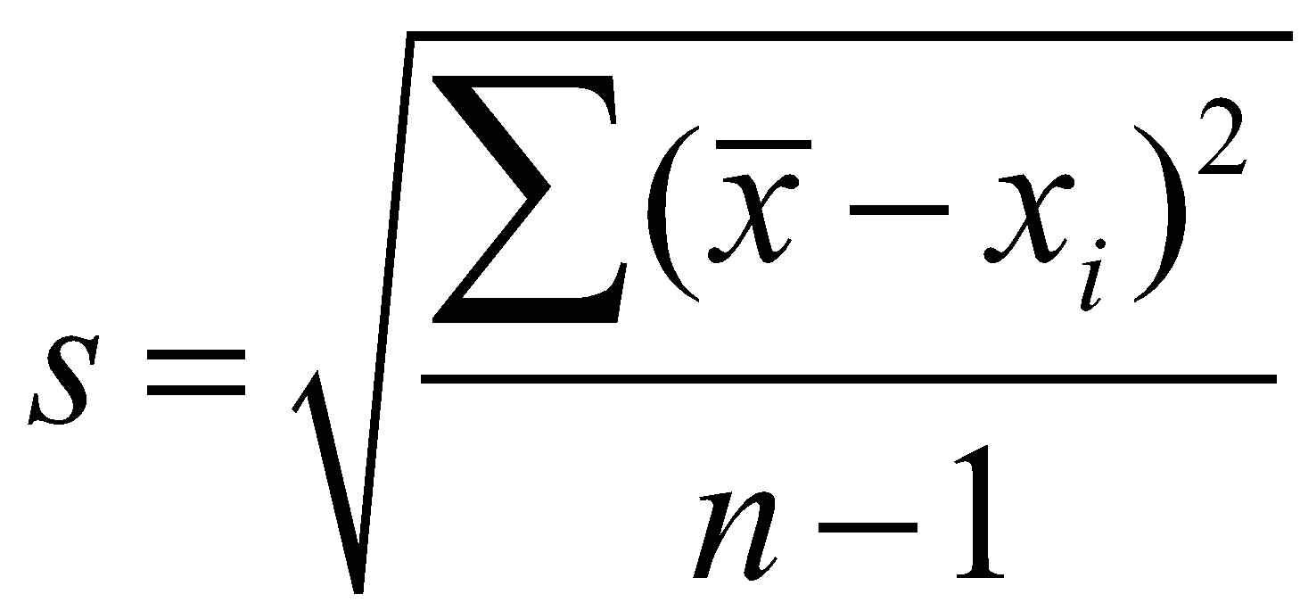
Problem 1: Basic statistics program
Write a program to output the average (a), the median (x), and the standard deviation (s), of a series of test values typed in by the user.
The median is the middle value in a list of values.
The standard deviation is a measure of how spread-out the data is and is calculated using this formula:
standard deviation: a quantity expressed by how much the members of a group differ from the mean value for the group.
Notes:
Average is easy, but for median we need to keep track of the items.
What are the algorithms?

Slide 5
Problem 1: Basic statistics program
We can calculate the average.
arrays_problem1_soln.py
… but we don’t yet have the tools for the median and standard deviation. We need to be able to store and sort items in a list somehow.

Slide 6
Concept: Arrays
An array is an indexed sequence of values associated with one variable.
Arrays can be fixed length or variable length.
Arrays can hold multiple values of the same type or different types.
5
3
2
4
7
1
3
Array values:
index
0
1
2
3
4
5
6

Slide 7
Python Arrays: Lists
In Python, an array is called a list.
To create a list:
list1 = [ ] # empty list
nums = [ 1, 2, 3, 4, 7, 8, 9, 10, 13, 14, 15 ]
# list of numbers
animals = ['cat', 'dog', ’baboon', 'bison’]
# list of strings
stuff = [ 1, 2, 'hello' ]
# mixed type list (yes we can do that)

Slide 8
Common Operations 1/5
Adding an item to a list
X =
5
3
2
4
X.append (3)
X =
5
3
2
4
3

Slide 9
Common Operations 2/5
Accessing an item in a list
X =
5
3
2
4
print (X[1])
3

Slide 10
Common Operations 3/5
Accessing the last item in a list
X =
5
3
2
4
print (X[-1])
4

Slide 11
Common Operations 4/5
Changing an item in a list
X =
5
3
2
4
X[2] = 7
X =
5
3
7
4

Slide 12
Common Operations 5/5
Iterating over items in list – processing each item in the list individually.
When you do not need to know the indices:
for a in X:
print(a)
When you do need to know the indices:
for n in range (len (X)):
print(n, X[n])

Slide 13
Example
This function finds the first occurrence of an item in a list. If the item does not exist, the function returns -1.
def index (values, item):
for i in range (len(values)):
if values[i] == item:
return i
return -1
What values are needed to test this program using different testing strategies?
Notes:
Value in the list 2, [4,5,6,6,2,2,29]
Value not in the list 2, [5.6,7,8,9,11,]

Slide 14
Exercise
Write a program to take 5 strings as input from the user and store them in an array. Then print them out in the same order from the array.

Slide 15
Unless otherwise stated, all materials are copyright of the University of Cape Town
© University of Cape Town

Slide 16
Introduction to Programming

Slide 17
Arrays
Using Array Operations
CSC1
Hussein Suleman
Department of Computer Science

Slide 18
Using Array Operations
Hussein Suleman
Department of Computer Science
University of Cape Town

Slide 19
Common Pitfall/Error
Accessing an item that is not in the list!
Python's response:
Traceback (most recent call last):
File "<string>", line 1, in <fragment>
builtins.IndexError: list index out of range
Solution:
Check the list length first and make sure the item exists!

Slide 20
Basic List Manipulation
Operation | Syntax | Example | Example output
Merging lists (concatenation) | <list1> + <list2> | X = [1,2] Y = [3,4] | [1,2,3,4]
Checking for item (membership) | <item> in <list> | X = [1, 2] 1 in X | True
Multiplying content of lists (repetition) | <list> * <n> | X = [1,2] X * 2 | [1,2,1,2]
Access list item (indexing) | <list>[<index>] | X = [1,2,3] X[2] | 3
Get length of list (length) | len(<list>) | X = [1,2,3,4] len(X) | 4
Delete item | del <list>[<i>] | X=[1,5,6,7] del X[2] | X=[1,5,7]
Get slice of list (slicing) | <list>[start:stop:step] | X = [4,5,6,7] X[1:3] | [5,6]
Iterate over list (iteration) | for <var> in <list>: | X = [2,4,6] for a in X: print (a+1) | 3 5 7
Notes:
We have used all these operations on strings (lists of characters) – but lists are mutable

Slide 21
Common List Functions
Function | Syntax | Example | X
 |  | X = [1,3,5,4,2]
Add element to end | <list>.append(<item>) | X.append(6) | X=[1,3,5,4,2,6]
Sort list | <list>.sort() | X.sort() | X=[1,2,3,4,5,6]
Reverse items | <list>.reverse() | X.reverse() | X=[6,5,4,3,2,1]
Find position of item | <list>.index(<item>) | Y = X.index(4) | Y=2
Insert item into list | <list>.insert(<i>,<item>) | X.insert(2,2) | X=[6,5,2,4,3,2,1]
Count occurrences of item | <list>.count(<item>) | Y=X.count(2) | Y=2
Remove first occurrence of item | <list>.remove(<item>) | X.remove(2) | X=[6,5,4,3,2,1]
Remove and return specified item | <list>.pop(<i>) | Y=X.pop(1) | Y=5, X=[6,4,3,2,1]
Split string into list | <string>.split(<sep>) | “4,7,3”.split(“,”) | ['4','7','3']
Join list into string | <sep>.join(<list>) | “-”.join(['4','7','3']) | “4-7-3”

Slide 22
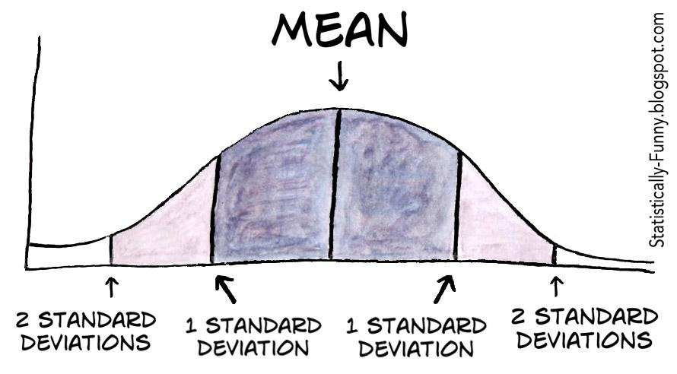
Problem 1: Basic statistics program
Write a program to output the median (x) and the standard deviation (s) of a series of values typed in by the user.
A plot of a normal distribution (or bell-shaped curve) where each band has a width of 1 standard deviation
Notes:
Do standard deviation

Slide 23
Problem 2
Write a program to act as the “Magic 8-ball”.
The Magic 8-Ball is a toy used for fortune-telling or seeking advice, developed in the 1950s and manufactured by Mattel.
It is often used in fiction, often for humor related to its giving accurate, inaccurate, or otherwise statistically improbable answers. [Wikipedia]

Slide 24
Problem 3
Write a program to perform some common list functions without using the built-in functions:
reverse
index
Did this one already
count

Slide 25
Problem 4
Write a program to generate custom spam.
The user must enter a list of names and a message.
Then the program must print out a customised message, in each case with <name> replaced by the actual name.
(This is called “templating”.)
e.g.
Congratulations <name> you have won R10 000 000! To claim your reward <name>, send your banking details to Ms Connie Art at another.mark@gmail.com. Don’t forget to include your bank login details!

Slide 26
Problem 5: The prefix-sum problem
Given a list of integers, input, produce output where output[i] is the sum of input[0]+input[1]+…+input[i]
Also called cumulative sum or scan.
If the values are [1,2,5,3,4], the prefix sums are [1,3,8,11,15].
slide adapted from: Sophomoric Parallelism and Concurrency, Lecture 3

Slide 27
Unless otherwise stated, all materials are copyright of the University of Cape Town
© University of Cape Town

Slide 28
Introduction to Programming

Slide 29
Arrays
2-D Arrays and Dictionaries
CSC1
Hussein Suleman
Department of Computer Science

Slide 30
2-D Arrays and Dictionaries
Hussein Suleman
Department of Computer Science
University of Cape Town

Slide 31
2-Dimensional Arrays
Each item in a list could itself be a list.
For example:
X = [[1,2], [3,4]]
2-D arrays/lists are equivalent to matrices or grids.
All operations work just as before, but every item is now a list.
To access an item, remember that X[0] will give us a list, so X[0][0] gives us the item in position (0,0) of the grid.

Slide 32
2-Dimensional Arrays
[0][0] | [0][1] | [0][2] | [0][3]
[1][0] | [1][1] | [1][2] | [1][3]
[2][0] | [2][1] | [2][2] | [2][3]
[3][0] | [3][1] | [3][2] | [3][3]
X

Slide 33
Problem 6
In computer graphics, a gradient fill is when the colour of an area gradually changes from one colour to another.
Write a program to output the result of a gradient fill on a 4x4 grid of pixels where the top-left pixel is 0 and the bottom-left is 6.
0 | 1 | 2 | 3
1 | 2 | 3 | 4
2 | 3 | 4 | 5
3 | 4 | 5 | 6

Slide 34
Dictionaries
Instead of a sequence with indices, Python also has a data structure with arbitrary index values and no order - this is called a dictionary.
A dictionary is a set of key=value pairs.
Dictionaries are very efficient for storing/retrieving values and mapping one list to another.
Define as follows:
D={'a':'apples', 'b':'bananas', 'p':'pears'}

Slide 35
Common Dictionary Operations
Function | Syntax | Example | X
Checking for key | <key> in <dict> | X = {1:2} 1 in X | True
Access dictionary item | <dict>[<key>] | X = {1:2, 3:4} X[3] | 4
Get keys | <dict>.keys() | X= {1:2, 3:4} X.keys() | [1,3]
Get values | <dict>.values() | X= {1:2, 3:4} X.values() | [2,4]
Delete item | del <dict>[<key>] | X= {1:2, 3:4} del X[3] | X={1:2}
Clear dictionary | <dict>.clear() | X = {1:2, 3:4} X.clear() | X={}
Iterate over keys | for <var> in <dict>: | X={1:'One',2:'Two’,3:'Three'} for a in X: print (X[a]) | One Two Three
slide adapted from: Sophomoric Parallelism and Concurrency, Lecture 3

Slide 36
Problem 7
Count the number of times each unique word occurs in a sentence. E.g.
It was a bright cold day in April, and the clocks were striking thirteen. Winston Smith, his chin nuzzled into his breast in an effort to escape the vile wind, slipped quickly through the glass doors of Victory Mansions, though not quickly enough to prevent a swirl of gritty dust from entering along with him.

Slide 37
Unless otherwise stated, all materials are copyright of the University of Cape Town
© University of Cape Town

Slide 38
Introduction to Programming

Slide 39
Arrays
Practical Data Structures
CSC1
Hussein Suleman
Department of Computer Science

Slide 40
Practical Data Structures
Hussein Suleman
Department of Computer Science
University of Cape Town

Slide 41
n-Dimensional Arrays
Lists can easily contain more than 2 dimensions.
For example a 3-d structure can be:
X=[ [[1,2],[3,4]], [[5,6],[7,8]], [[9,10],[11,12]] ]
X[1][1][0]= ?
Suppose we want to store a list of students, with a list of courses for each student, and a list of test dates for each course, and a list of chapters per test, we could use the following 4-d list:
students = [['saleem',['csc1015f',['12 april',['5','6','7']]]]]

Slide 42
Generic structures
Every data structure is generic. So just as it is possible to have n-dimensional lists, you can have dictionaries of lists, list of dictionaries, etc.
D = {'kayleigh':[12,23,31],
'callum':[45,54,55]}
E = [{'name':'palesa','year':1},
{'name':'luqmaan','year':1}]

Slide 43
Problem 8: Battleships
Write a single-player Battleships game
The user is presented with a 10x10 grid with hidden warships and must guess the locations of these warships until all are hit.

Slide 44
Arrays in Functions
Passing arrays to functions
In Python, the values of actual parameters cannot be changed in a function.
Arrays cannot be replaced.
HOWEVER, the contents of arrays can be changed.
This is a way of passing back multiple values from a function

Slide 45
Exercise: Scope and Arrays
What is the exact output of this code?
#scope.py - illustrating scope
def tester(myArr):
print("In function, before append",myArr)
myArr.append('a')
print("In function, after append",myArr)
myArr=['a','b','c']
print("In function, after reassignment",myArr)
print()
arrMain=["one","two","three"]
print("Before function call", arrMain)
tester(arrMain)
print("After function call", arrMain)

Slide 46
Reminder: Scope and Lifetime
Not all variables are accessible from all parts of our program, and not all variables exist for the same amount of time.
Where a variable is accessible and how long it exists depend on how it is defined.
The part of a program where a variable is accessible or modifiable is called a scope.
The duration for which the variable exists is its lifetime.
Formal parameters can also only be seen inside the function, even if they have the same name.

Slide 47
Reminder: Scope
A variable that is defined in the main body of a file is called a global variable.
It will be visible throughout the file, and also inside any file that imports that file.
A variable that is defined inside a function is local to that function.
It is accessible from the point at which it is defined until the end of the function and it exists for as long as the function is executing.
The parameter names in the function definition behave like local variables.
But they contain the values that we pass into the function when we call it.

Slide 48
Reminder: Global variables
global / nonlocal
Python parameters can be declared as global in a function to indicate that the variable being used is actually declared outside any functions. This is not recommended in general.
nonlocal can be used similarly for nested functions.

Slide 49
Poll
What is scope?
A – where a variable has a value
B – where a variable can be accessed/changed
C – where a variable is stored
D – where a variable overrides another

Slide 50
Solution
What is scope?
A – where a variable has a value
B – where a variable can be accessed/changed
C – where a variable is stored
D – where a variable overrides another

Slide 51
Poll
When can you read a global variable?
A – if the name is not overridden locally
B – when you use the word nonlocal
C –only when you use the prefix “global”
D – when the variable is defined in a module

Slide 52
Solution
When can you read a global variable?
A – if the name is not overridden locally
B – when you use the word nonlocal
C –only when you use the prefix “global”
D – when the variable is defined in a module

Slide 53
Poll
When can you write to a global variable?
A – if the name is not overridden locally
B – when you use the word nonlocal
C –only when you use the prefix “global”
D – when the variable is defined in a module

Slide 54
Solution
When can you write to a global variable?
A – if the name is not overridden locally
B – when you use the word nonlocal
C –only when you use the prefix “global”
D – when the variable is defined in a module

Slide 55
Exercise
Describe briefly, and in clear English, what the function Enigma returns.
def Enigma(lst,item):
tmp=[]
for i in lst:
if i!= item:
tmp.append(i)
return tmp
Notes:
The function Engima takes a list and an item and returns a new list with all instances of the item removed.

Slide 56
Exercise
Write down the exact output:
def main():
list1=[2,4,6,6,8,10]
list2=["Skipper","Kowalski","Rico","Private","King Julian"]
list3=[[1,2],[3,4],[5,6]]
print(Enigma(list2,"King Julian"))
print(Enigma(list1,9))
main()
Notes:
The function Engima takes a list and an item and returns a new list with all instances of the item removed.

Slide 57
Unless otherwise stated, all materials are copyright of the University of Cape Town
© University of Cape Town

