Slide 1
Introduction to Programming

Slide 2
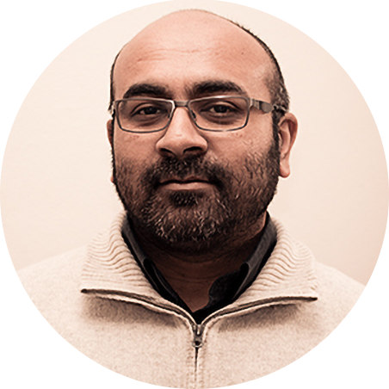
Functions
Introduction to Functions
CSC1
Hussein Suleman
Department of Computer Science

Slide 3
Introduction to Functions
Hussein Suleman
Department of Computer Science
University of Cape Town

Slide 4
Problem 1 Introduction
Write a program to print out the reverse of a sentence.
For example:
Computer becomes retupmoC
Use first principles - i.e., process the string character-by-character.
Use functions to make your program readable/modular.

Slide 5
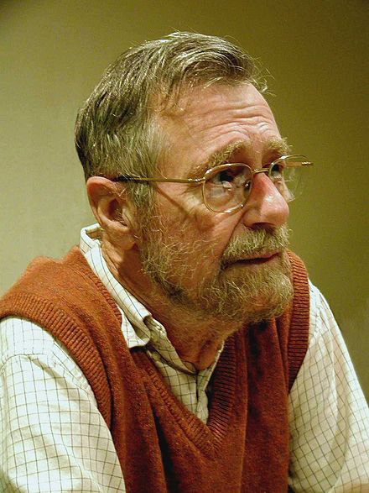
“Go to considered harmful”
“I was terribly frightened. …
I would sit all evening silently staring at the white walls in our living room. Finally, one night at half past two, my wife collected me weeping on the carpet in that room.
From that moment I realized that something had to be done. I started writing 'Notes on Structured Programming' for therapeutic reasons. When that text was written, I knew what I had to do, and I knew how I was going to attack it ....
‘Notes on Structured Programming’ broke on the computing community with the force of a revolution. For several years, people had known that something was seriously wrong with software.”
Edsger Dijkstra (1930-2002)
Dutch Computer Scientist, speaking on Structured Programming in 1968
Olson, Steve. "Sage of software." Science '84, vol. 5, Jan.-Feb. 1984, pp. 74+. Gale Academic.

Slide 6
Function
A function is a named block of statements that can be executed/called within a program.
We have already used some functions:
print, eval, round, ...
Python stops what it is doing, runs the function, then continues from where it stopped.
Functions enable reuse and modularity of code.
Functions help us to write longer/more complex programs.

Slide 7
So far:
# reverse an integer without using strings
number = eval (input ("Enter a number: "))
reverse = 0
while number > 0:
digit = number % 10
number = int(number / 10)
reverse = reverse * 10 + digit
print (reverse)

Slide 8
Function - example
# our program
# reverse an integer without using strings
number = eval (input ("Enter a number: "))
reverse = 0
while number > 0:
digit = number % 10
number = int(number / 10)
reverse = reverse * 10 + digit
print (reverse)
# somewhere else
def input (someString):
#function to read from standard input
def eval (aStringNumber):
#converts string to number
def int(aString or aFloat):
#returns an integer using floor function
def print(oneOrMoreStrings):
#outputs the strings to standard output

Slide 9
Function Definition / Use
Functions can be defined and used in any order, as long as they are used after definition.
To define a function:
def some_function ():
statement1
statement2
...
To use/call/invoke a function:
some_function ()

Slide 10
Code refactoring
Functions can refactor code to avoid duplication
print ("Welcome")
print ("to")
print ("CS1")
print ("Welcome")
print ("to")
print ("CS2")
print ("Welcome")
print ("to")
print ("CS3")
def welcome():
print ("Welcome")
print ("to")
welcome ()
print ("CS1")
welcome ()
print ("CS2")
welcome ()
print ("CS3")

Slide 11
Poll
Why do we use functions when we write programs?
A – to reuse code
B – to write large, modular programs
C – to increase code readability
D – all of the above

Slide 12
Solution
Why do we use functions when we write programs?
A – to reuse code
B – to write large, modular programs
C – to increase code readability
D – all of the above

Slide 13
Poll
What Python keyword is used to define a function?
A – func
B – def
C – function
D – define

Slide 14
Solution
What Python keyword is used to define a function?
A – func
B – def
C – function
D – define

Slide 15
Exercise
Write a function to print the sequence of integers 1-10, each on a new line.
Execute the function once.

Slide 16
Unless otherwise stated, all materials are copyright of the University of Cape Town
© University of Cape Town

Slide 17
Introduction to Programming

Slide 18
Functions
Parameters
CSC1
Hussein Suleman
Department of Computer Science

Slide 19
Parameters
Hussein Suleman
Department of Computer Science
University of Cape Town

Slide 20
Parameters
Parameters allow variation in function behaviour
print ("Welcome")
print ("to")
print ("CS1")
print ("Welcome")
print ("to")
print ("CS2")
print ("Welcome")
print ("to")
print ("CS3")
def welcome(grp):
print ("Welcome")
print ("to")
print (grp)
welcome ("CS1")
welcome ("CS2")
welcome ("CS3")

Slide 21
Parameters
Every function can have a list of parameters in its definition.
called the formal parameters
Whenever the function is called/invoked a value must be provided for each of the formal parameters
called the actual parameters or arguments
Within the function body, the parameters can be used like variables.

Slide 22
Formal and Actual Parameters
def some_function (a, b, c):
print (a)
print (b+c)
some_function (12, 23, 34)
formal parameters
(or just “parameters”)
actual parameters
or “arguments”

Slide 23
Pass-By-Value
Only a copy of the value of a parameter is ever sent to a function.
So if there is an original variable, it cannot be changed by the function changing the parameter.

Slide 24
Pass-By-Value
def some_function (a):
a=a+1
print (a)
b = 12
some_function (b)
print (b)
output
13
12

Slide 25
Return Values
Functions can return values just like mathematical functions.
Use the return statement with an expression.
Can be used anywhere in function and will return immediately.

Slide 26
Return Values
def square (x):
return x*x
y = square (12)
print (y)
output
144

Slide 27
Poll
What is a formal parameter?
A – name used within function
B – value passed to function
C – name associated with arguments
D – formal names used anywhere in program

Slide 28
Solution
What is a formal parameter?
A – name used within function
B – value passed to function
C – name associated with arguments
D – formal names used anywhere in program

Slide 29
Poll
When does the name a refer to an actual parameter?
A – return a
B – a=dosomething()
C – def dosomething(a)
D – dosomething(a)

Slide 30
Solution
When does the name a refer to an actual parameter?
A – return a
B – a=dosomething()
C – def dosomething(a)
D – dosomething(a)

Slide 31
Exercise
Write a function to print the sequence of integers 1-n, each on a new line, depending on the value of the parameter n.
Execute the function for values 3, 5 and 7.

Slide 32
Unless otherwise stated, all materials are copyright of the University of Cape Town
© University of Cape Town

Slide 33
Introduction to Programming

Slide 34
Functions
Identifier Scope
CSC1
Hussein Suleman
Department of Computer Science

Slide 35
Identifier Scope
Hussein Suleman
Department of Computer Science
University of Cape Town

Slide 36
Scope and Local Variables
Scope refers to where a variable can be used (accessed or changed).
New variables can be created and used within functions but they disappear when the function ends.
called local variables
Limiting scope:
Prevents errors in one part of a program affecting other parts.
Helps programmers to manage large programs.

Slide 37
Scope and Local Variables
def some_function ():
a = 1
print (a)
some_function ()
output
1

Slide 38
Scope and Local Variables
Local variable names (and parameters) that are the same as global variable names temporarily hide the global variables.

Slide 39
Scope and Local Variables
def some_function (a,c):
a = 3
b = 3
print (a,b)
a = 1
b = 2
some_function (1,2)
print (a,b)
output
33
12

Slide 40
Global Variables
Global variables are not within any function.
Global variables can be accessed but not changed.
Use the global statement to allow changes to a global variable.

Slide 41
Global Variables
def some_function (a):
global b
b = 4
a = 3
b = 2
some_function (b)
print (b)
output
4

Slide 42
Poll
Why is scope important?
A – avoid having to track lots of variables
B – prevent programming errors
C – so we know which variable a name refers to
D – All of the above

Slide 43
Solution
Why is scope important?
A – avoid having to track lots of variables
B – prevent programming errors
C – so we know which variable a name refers to
D – All of the above

Slide 44
Unless otherwise stated, all materials are copyright of the University of Cape Town
© University of Cape Town

Slide 45
Introduction to Programming

Slide 46
Functions
Problem 1
CSC1
Hussein Suleman
Department of Computer Science

Slide 47
Problem 1
Hussein Suleman
Department of Computer Science
University of Cape Town

Slide 48
Problem 1
Write a program to print out the reverse of a sentence.
For example:
Enter a sentence: Computer
retupmoC
Use first principles - i.e., process the string character-by-character.
Use functions to make your program readable/modular.

Slide 49
Unless otherwise stated, all materials are copyright of the University of Cape Town
© University of Cape Town

Slide 50
Introduction to Programming

Slide 51
Functions
Modular Code
CSC1
Hussein Suleman
Department of Computer Science

Slide 52
Modular Code
Hussein Suleman
Department of Computer Science
University of Cape Town

Slide 53
docstring
Functions should be documented by specifying their purpose in a string immediately after the header.
It is recommended that you use """ (triple quotes - for multi-line strings) for all docstrings.
Use func.__doc__ to check the docstring.

Slide 54
docstring
def cube (x):
"""Return the cube of x."""
return x*x*x
def square (x):
"""Return the square of x. x can be any numerical value"""
return x*x

Slide 55
nested functions
Functions can be composed similarly to mathematical functions.
def cube (x):
return x*x*x
def square (x):
return x*x
def power (a, b):
return a**b
print (power (cube (2), square (2)))

Slide 56
main function
Common practice is to wrap a program into a function called "main", then invoke this function to execute the program.
# cube program
def cube (x):
return x*x*x
def main ():
print (cube (2))
main()

Slide 57
Writing your own modules
Any file with functions can be imported.
Check __name__ variable
if it is "__main__", then this file was executed
otherwise, this file was imported

Slide 58
Writing your own modules
# cube module
def cube (x):
return x*x*x
def main ():
print (cube (2))
if __name__=="__main__":
main()
# test cube module
import a
print (a.cube(3))

Slide 59
Exercise
Modify the program to reverse a string such that it can be used as a separate reusable module.
Use a main function that asks for input and prints the reversed string, as before.

Slide 60
Unless otherwise stated, all materials are copyright of the University of Cape Town
© University of Cape Town

Slide 61
Introduction to Programming

Slide 62
Functions
Problem 2-3
CSC1
Hussein Suleman
Department of Computer Science

Slide 63
Problem 2-3
Hussein Suleman
Department of Computer Science
University of Cape Town

Slide 64
Problem 2
Write a function that prints a text heading inside a box made up of + characters.
Store this function as a module.
Use an optional parameter to specify the padding within the box.
output
+++++++++
+ Hello +
+++++++++

Slide 65
Default values for parameters
Functions can have zero or more parameters with default values in their definition.
All parameters with default values must be at the end of the parameter list.
e.g., once you have a default value, all subsequent parameters must have a default value as well.

Slide 66
Default values for parameters
Evaluated at the time of function definition, not invocation.
Whenever the function is called/invoked, the arguments with default values are optional.
Within the function body, parameters are still used as variables.

Slide 67
Recall: Formal Parameters
def some_function (a, b, c):
print (a)
print (b+c)
some_function (12, 23, 34)
formal parameters
actual parameters

Slide 68
Default values for formal parameters
def some_function (a, b, c=10):
print (a)
print (b+c)
some_function (12, 23, 34)
some_function (12, 23)
formal parameter
with default value
optional parameter

Slide 69
Problem 2
Write a function that prints a text heading inside a box made up of + characters.
Store this function as a module.
Use an optional parameter to specify the padding within the box.
output
+++++++++
+ Hello +
+++++++++

Slide 70
Problem 3
There are special Unicode characters for box corners and edges.
For example “\u250F” is the top left corner symbol.
Modify your heading program to use these characters instead of “+”.
output
┏━━━┓
┃ X ┃
┗━━━┛
# Unicode box test
print ("\u250F\u2501\u2501\u2501\u2513\n")
print ("\u2503 X \u2503\n\u2517\u2501\u2501\u2501\u251B\n")

Slide 71
Unless otherwise stated, all materials are copyright of the University of Cape Town
© University of Cape Town

