Slide 1
Introduction to Programming

Slide 2
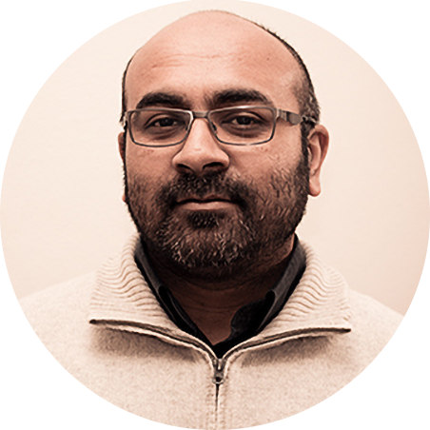
Recursion
The Concept of Recursion
CSC1
20 March 2021
Hussein Suleman
Department of Computer Science

Slide 3
Recursion
Hussein Suleman
Department of Computer Science
University of Cape Town

Slide 4
Concept: Recursion
It was a dark and stormy night, and the head of the brigands said to Antonio:“Antonio, tell us a tale”. And so Antonio began:
“It was a dark and stormy night and the head of the brigands said to Antonio, “Antonio, tell us a tale”. And so Antonio began:
“It was a dark and stormy night and the head of the brigands said to Antonio, “Antonio, tell us a tale”. And so Antonio began:
“It was a dark and stormy night and the head of the brigands said to Antonio, “Antonio, tell us a tale”. And so Antonio began:
“It was a dark and stormy night and the head of the brigands said to Antonio, “Antonio, tell us a tale”. And so Antonio began:
“It was a dark and stormy night and ….

Slide 5
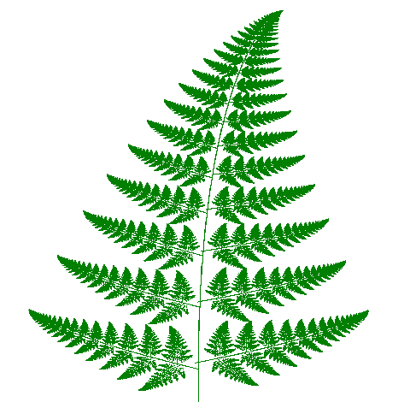
Concept: Recursion
The fern leaf

Slide 6
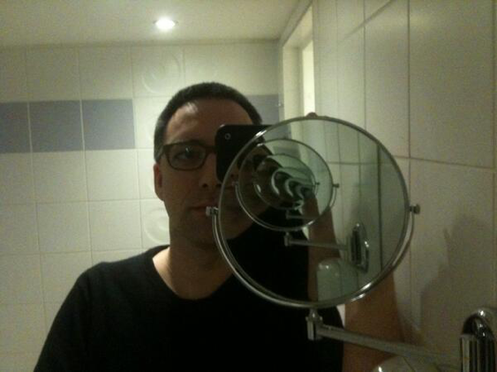
Concept: Recursion
Selfies with mirrors

Slide 7
Recursive definitions:
A description of something that refers to itself is called a recursive definition.
e.g.
GNU: GNU is Not Unix

Slide 8
Recursive definitions
A recursive definition of the ancestors of person p:
p’s parents are p’s ancestors (base case);
The parents of any ancestors of p are also the ancestors of p (recursive step).
p

Slide 9
Recursive definitions:
A description of something that refers to itself is called a recursive definition.
e.g.
The set of prime numbers can be defined as the unique set of positive integers satisfying:
1 is not a prime number
any other positive integer is a prime number if and only if it is not divisible by any prime number smaller than itself.
But how is this useful to computer science …

Slide 10
Recursive Functions
A function can call itself.
A function that does this is a recursive function.
def brigand():
print("It was a dark and stormy night, and the head of the brigands said to Antonio:“Antonio, tell us a tale”. And so Antonio began:")
brigand()
brigand()

Slide 11
Recursive Functions
A recursive function is a function that includes a call to itself, based on the general problem-solving technique of breaking down a task into subtasks.
Recursion can be used whenever one subtask is a smaller version of the original task.

Slide 12
Defining recursive functions
A recursive function calls itself.
Recursive functions have 2 key elements:
one or more recursive calls.
stopping condition, or base case, where no recursion is required.
Recursion is the equivalent of mathematical induction!

Slide 13
Example: Recursive Functions
Now, with a base case
def brigand(n):
if n==0:
print(“and he immediately finished.")
else:
print("It was a dark and stormy night, and the head of the brigands said to Antonio:“Antonio, tell us a tale”. And so Antonio began:")
brigand(n-1)

Slide 14
Unless otherwise stated, all materials are copyright of the University of Cape Town
© University of Cape Town

Slide 15
Introduction to Programming

Slide 16
Recursion
Factorial
CSC1
20 March 2021
Hussein Suleman
Department of Computer Science

Slide 17
Factorial
Hussein Suleman
Department of Computer Science
University of Cape Town

Slide 18
Poll
Why is recursion important?
A – define problems in terms of smaller problems
B – elegant and natural solutions
C – analogous to mathematical induction
D – all of the above

Slide 19
Solution
Why is recursion important?
A – define problems in terms of smaller problems
B – elegant and natural solutions
C – analogous to mathematical induction
D – all of the above

Slide 20
Poll
What are the features present in most recursive functions?
A – function that is nested, nonlocal
B – function that calls itself, base case
C – global variables, main calling functions
D –modules, def main ()

Slide 21
Solution
What are the features present in most recursive functions?
A – function that is nested, nonlocal
B – function that calls itself, base case
C – global variables, main calling functions
D –modules, def main ()

Slide 22
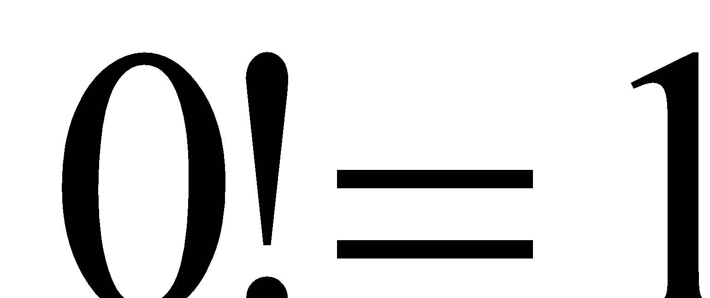
Recursion: Factorial
Classic introductory example - Factorial function:
# recursive call
for n>=1
# stopping condition, or base case

Slide 23
Recursion: Factorial - derivation
We know:
n!= 1 x 2 x 3 x 4 … (n-2) x (n-1) x n
Then,
(n-1)!= 1 x 2 x 3 x 4 … (n-2) x (n-1)
Thus, n! = n x (n-1)!
This is a recursive definition in terms of a smaller problem.
All, we then need is a stopping condition, and n=0 works since factorials are defined for natural numbers.

Slide 24
Recursive Factorial function
def factRec(n):
if n==0:
return 1 #base case – ends recursion
else:
return n*factRec(n-1)
#recursive call – does a little work and uses the results from smaller version of same problem
function definition – must have parameter

Slide 25
Further explanation - Recursion: Factorial
Classic introductory example - Factorial function:
for n>=1
# recursive call
# stopping condition, or base case
5!=5*4!
4*3!
3*2!
2*1!
1*0!
1

Slide 26
Further explanation - Recursion: Factorial
Classic introductory example - Factorial function:
for n>=1
# recursive call
# stopping condition, or base case
5!=5*4!
4*3!
3*2!
2*1!
1*1

Slide 27
Further explanation - Recursion: Factorial
Classic introductory example - Factorial function:
for n>=1
# recursive call
# stopping condition, or base case
5!=5*4!
4*3!
3*2!
2*1

Slide 28
Further explanation - Recursion: Factorial
Classic introductory example - Factorial function:
for n>=1
# recursive call
# stopping condition, or base case
5!=5*4!
4*3!
3*2

Slide 29
Further explanation - Recursion: Factorial
Classic introductory example - Factorial function:
for n>=1
# recursive call
# stopping condition, or base case
5!=5*4!
4*6

Slide 30
Further explanation - Recursion: Factorial
Classic introductory example - Factorial function:
for n>=1
# recursive call
# stopping condition, or base case
5!=5*24

Slide 31
Further explanation - Recursion: Factorial
Classic introductory example - Factorial function:
for n>=1
# recursive call
# stopping condition, or base case
120

Slide 32
Iterative solution: Factorial function
def fact(n):
f=1
for i in range(1,n+1):
f=f*i
return f

Slide 33
Unless otherwise stated, all materials are copyright of the University of Cape Town
© University of Cape Town

Slide 34
Introduction to Programming

Slide 35
Recursion
Recursion Problems
CSC1
20 March 2021
Hussein Suleman
Department of Computer Science

Slide 36
Recursion Problems
Hussein Suleman
Department of Computer Science
University of Cape Town

Slide 37
Problem 1
Write a recursive function to sum the first n positive integers.
#fill in the code for this function
def sum (n):
#code goes here
#what is the base case?
#what is the recursive step?

Slide 38
More Recursion Problems
Problem 2: Calculate x^{n}
Problem 3: Count the number of characters in a string.
Problem 4: Count the number of words in a list.
Problem 5: Search/replace characters in a string.
Problem 6: Calculate Greatest Common Divisor (GCD).
Euclid’s Algorithm.
Problem 7: Draw a triangle of height n.
Problem 8: Print out a list of values.
Problem 9: Reverse a string.
Problem 10: Find the sum of integers from m to n.

Slide 39
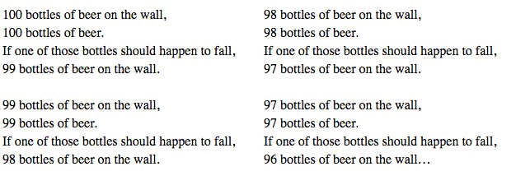
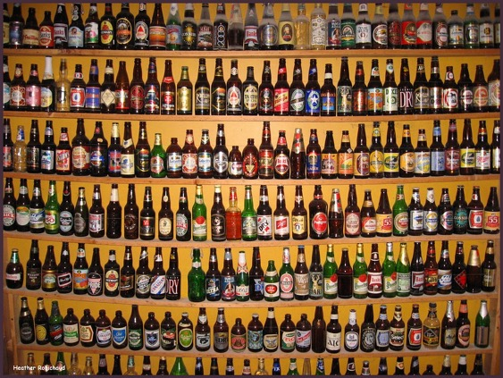
Fun with recursion

Slide 40
Pitfall: Infinite Recursion
In our examples, the series of recursive calls eventually reached a call of the method that did not involve recursion (a stopping case).
If instead, every recursive call had produced another recursive call, then a call to that method would, in theory, run forever.
This is called infinite recursion.
In practice, such a method runs until the computer runs out of resources, and the program terminates abnormally.

Slide 41
Infinite recursion example
def sumRec(n):
if n==0:
return 0
else:
return sumRec(n)+n #logic error here

Slide 42
A Closer Look at Recursion
When the computer encounters a recursive call, it must temporarily suspend its execution of a function
It does this because it must know the result of the recursive call before it can proceed
It saves all the information it needs to continue the computation later on, when it returns from the recursive call
Ultimately, this entire process terminates when one of the recursive calls does not depend upon recursion to return.

Slide 43
What's Happening Inside Python
Python keeps track of every function that has been called in a part of memory called a stack.
This allows Python to return to the next point after a function call.
The same holds for recursive functions.
e.g., sum(3) calls sum(2) calls sum(1) calls sum(0)
sum(0)
sum(1)
sum(2)
sum(3)

Slide 44
Unless otherwise stated, all materials are copyright of the University of Cape Town
© University of Cape Town

Slide 45
Introduction to Programming

Slide 46
Recursion
Towers
CSC1
20 March 2021
Hussein Suleman
Department of Computer Science

Slide 47
Towers
Hussein Suleman
Department of Computer Science
University of Cape Town

Slide 48
Towers of Hanoi
Problem: Move a stack of discs one disc at a time from one tower to another, such that no disc may be placed on a larger disc.
puzzle game invented in the late 1800s

Slide 49
Hanoi
a
b
c

Slide 50
Hanoi: 1 disk
a
b
c

Slide 51
Hanoi: 2 disks
a
b
c

Slide 52
Hanoi: 3 disks
1
2
3
a
b
c

Slide 53
Hanoi: 4 disks
1
2
3
4
c

Slide 54
Towers of Hanoi
Algorithm:
Move n-1 discs from source to spare tower
Move nth disc from source to destination tower
Move n-1 discs from spare to destination tower
Stop when no more discs … or one disc
https://www.youtube.com/watch?v=rVPuzFYlfYE
Notes:
ef hanoi(n,source,dest): #three poles, labelled 1,2,3
if n>0:
spare=6-source-dest
hanoi(n-1,source,spare)
print("Move disk",n,"from",source,"to",dest)
hanoi(n-1,spare,dest)

Slide 55
Exercise
Write a program to show the steps in the Towers of Hanoi solution.

Slide 56
Exercise: what does this function compute?
def mystery(x):
if x==1:
return 2
if x==0:
return 1
return 2*mystery(x-1)

Slide 57
Problem 11
Draw a half-hourglass using a recursive function
Hourglass(“MARSUPIAL”)
MARSUPIAL
MARSUPIA
MARSUPI
MARSUP
MARSU
MARS
MAR
MA
M
MA
MAR
MARS
MARSU
MARSUP
MARSUPI
MARSUPIA
MARSUPIAL
Notes:
def Hourglass(s): if s: print(s) Hourglass(s[:-1]) print(s)

Slide 58
Unless otherwise stated, all materials are copyright of the University of Cape Town
© University of Cape Town

Slide 59
Introduction to Programming

Slide 60
Recursion
Fibonacci and Performance
CSC1
20 March 2021
Hussein Suleman
Department of Computer Science

Slide 61
Fibonacci and Performance
Hussein Suleman
Department of Computer Science
University of Cape Town

Slide 62
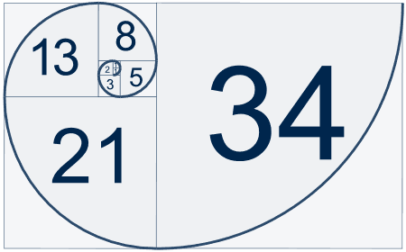
Iterative Fibonacci numbers
A Fibonacci number is the sum of the previous 2 Fibonacci numbers.
0, 1, 1, 2, 3, 5, 8, 13, …
def fib(n):
curr=1
prev=1
for i in range(n-2):
curr,prev=curr+prev,curr
return curr

Slide 63
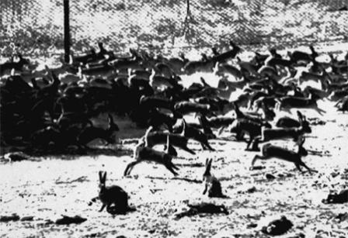
Fibonacci in Australia
In 1859, a farmer introduced 24 grey rabbits to remind him of home. At the time, the man wrote:
"The introduction of a few rabbits could do little harm and might provide a touch of home, in addition to a spot of hunting."
For one pair, by 1900….(480 months)…
Fib(480)
Notes:
Compare iterative versus recursive…

Slide 64
Problem 12: Recursive Fibonacci numbers
Recursive step:
Every Fibonacci number is the sum of the previous two numbers.
fib(n) = fib(n-2) + fib(n-1)
Base case:
The first 2 Fibonacci numbers are 0 and 1.
fib(0) = 0
fib(1) = 1

Slide 65
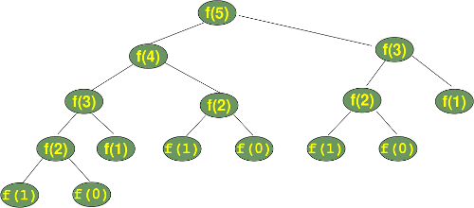
Recursive Fibonacci numbers
Elegant solution.
Not very efficient, because of many duplicate function calls

Slide 66
Recursion Versus Iteration
Recursion is not absolutely necessary.
Any task that can be done using recursion can also be done in a non-recursive manner.
A non-recursive version of a method is called an iterative version.
An iteratively written method will typically use loops of some sort in place of recursion.
A recursively written method can be simpler, but will usually run slower and use more storage than an equivalent iterative version.

Slide 67
Iterative version of prefix sum
#iterative definition
def prefixSum(arr):
tmp=[]
for i in range(len(arr)):
if i==0:
tmp.append(arr[0]) #the first one is just a copy
else:
tmp.append(tmp[i-1]+arr[i]) #cummulative sum
return tmp

Slide 68
Exercise: Recursive prefix sum
# recursive definition
def prefixSumRec(arr):
# fill in the rest of the function
# test code
print (prefixSumRec ([1,5,2,7,4,6,5,3,6]))

Slide 69
Exercise: What does this function display?
def pattern(s,n):
if n==0:
return
print(s)
pattern('-'+s,n-1)
print(s)

Slide 70
Problem 13
A nested number list is a list whose elements are either:
numbers
nested number lists
e.g. [1, 2, [11, 13], [8,[2,3]]]
Write a recursive function to sum all the numbers in a nested number list
e.g. r_sum([1, 2, [11, 13], [8,[2,3]]]) returns 40

Slide 71
Recursive partitioning
Which is the more efficient algorithm?
def recPow( a,n):
"""raises a to power n"""
if n==0: return 1
else:
return a*recPow(a,n-1)
def recPowAlt ( a,n):
"""raises a to power n"""
if n==0: return 1
else:
factor=recPowAlt(a,n//2)
if n%2==0:
return factor*factor
else:
return factor*factor*a

Slide 72
Recursion - Justification
Recursion is one of the most important ideas in computer science, but it's usually viewed as one of the harder parts of programming to grasp.
We can work out very concise and elegant solutions to problems by thinking recursively.
Basic approach traversing for non-linear data structures, such as trees.

Slide 73
Recursion – Justification (2)
Also, there are problems whose solutions are inherently recursive, because they need to keep track of prior state. e.g.:
divide-and-conquer algorithms such as Quicksort (coming soon….)
All of these algorithms can be implemented iteratively with the help of a stack, but the need for the stack arguably nullifies the advantages of the iterative solution.

Slide 74
Recursion and Functional Languages
Recursion is a key concept for functional programming languages, such as Haskell.
Lisp is the second-oldest high-level programming language in widespread use today; only Fortran is older.
Recursion is a key component of language.
Closely related to AI and formal logic.
Resurgence today, especially for parallel programming.

Slide 75
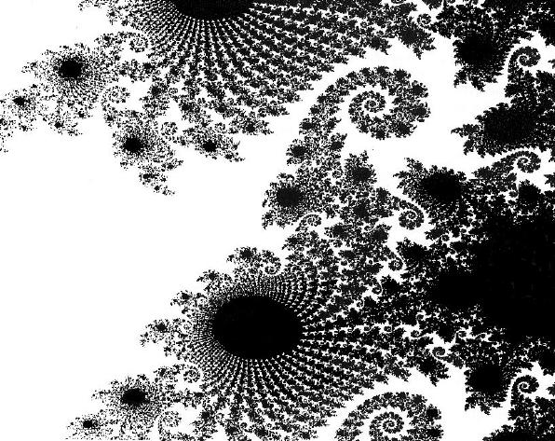
Thinking Recursively
There is no infinite recursion
Every chain of recursive calls must reach a stopping case
Each stopping case returns the correct value for that case
For the cases that involve recursion: if all recursive calls return the correct value, then the final value returned by the method is the correct value
These properties follow a technique also
known as mathematical induction

Slide 76
Unless otherwise stated, all materials are copyright of the University of Cape Town
© University of Cape Town

